Slide 1

RUNGTA COLLEGE OF DENTAL SCIENCES & RESEARCH
Fibrosseous lesions of jaws &
Osteodystrophies
Dr. Fatima Khan
ORAL MEDICINE, DIAGNOSIS & RADIOLOGY

Slide 2
PART II

Slide 3
PERIAPICAL CEMENTO‐OSSEOUS DYSPLASIA:
Periapical cemento-osseous dysplasia (PCOD) and focal cemento-osseous dysplasia (FCOD) represent the most common fibro-osseous lesions of the jaws
CLINICALPRESENTATION:
Periapical cemento-osseous dysplasia (PCOD) is an asymptomatic benign lesion. The term cementoma is often used for this condition, although, it is not a neoplasm. PCOD occurs most commonly in the anterior mandible of patients older than 30 years of age
It is more common in women than in men, and there is a predominance in black women .
Related teeth are almost invariably vital

Slide 4
Radiographic Features
PCOD appears in radiographs taken for other reasons . It displays three different characteristics according to its period. In the first period, which is also called osteolytic period
In the second period, which may also be called as cementoblastic period or intermediate period, small calcifications occur within the lesion. A mixed radiolucent and radiopaque appearance emerges.
In the third period, lesions display massive calcifications.

Slide 5
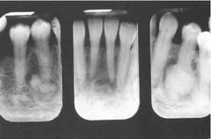

Slide 6
FLORID CEMENTO‐OSSEOUS DYSPLASIA:
Florid cemento-osseous dysplasia (FLCOD) has been described as a condition that usually manifests as multiple radiopaque cementum-like masses distributed throughout the jaws. This condition has also been classified as gigantiform cementoma, chronic sclerosing osteomyelitis and sclerosing osteitis.
CLINICAL PRESENTATION:
Florid cemento‐osseous dysplasia refers to a set of radiolucent‐radiopaque periapical and interradicular lesions involving the mandible bilaterally and sometimes the maxilla. It is basically an extended form of periapical cemento‐osseous dysplasia. These lesions are also asymptomatic

Slide 7
RADIOGRAPHIC FEATURES:
Radiographically, the lesions appear as multiple sclerotic
radiographically demonstrable opacification, FCOD often displays very little fibrotic stroma with thick curvilinear trabeculae (‘‘ginger root’’ pattern) or irregularly shaped cementum-like masses, located in the maxilla or mandible.

Slide 8
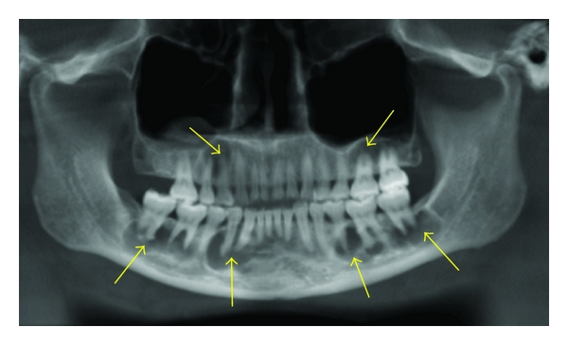

Slide 9
OSSIFYING FIBROMA
Pindborg,J.J(1965) stated that ossifying fibroma(OF) is one of the most common osteogenic lesions of the jaws and defines ossifying fibroma as a sharply demarcated,intraosseous benign tumor that occurs in a single bone and shows gradual transformation of a cell rich connective tissue into the bone.
CLINICAL FEATURES:
Age: Mostly seen in third to fourth decades of life
Sex: Has predilection for females, female to male ratio 5:1
Race: White
Site and Location: Premolar and Molar region of the mandible.

Slide 10
Radiographic Features
OF grows in a centrifugal fashion, producing a ball like circular lesion. The lesion enlarges equally in all directions, producing expansion of the buccal or lingual cortical plates and inferior cortex of the mandible the expanded inferior cortex is exactly parallel to the margins of the tumor mass above.

Slide 11
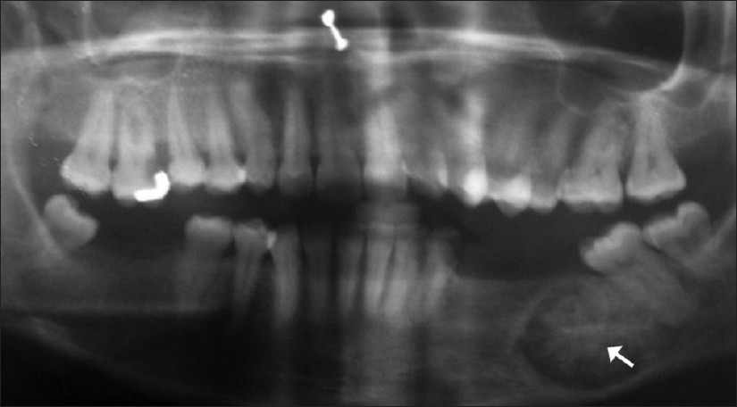

Slide 12
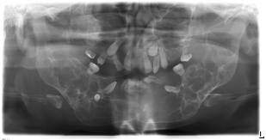
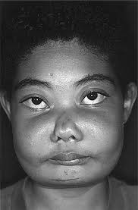
Cherubism
Cherubism is an uncommon ﬁbro-osseous disorder of the jaws that presents with varyingdegrees of involvement and a tendency toward spontaneous remission.
Lesions are characterized by replacement of bone with ﬁbrovascular tissue containing abundant multinucleated giant cells.

Slide 13
Clinical n radiographic features
Childrens,2-6yrs
Frequency is rare
Site-angle/post mandible/bilateral
Size is variable one to several centimeters in diameter and may fill the whole jaw.
Shape-multilocular/symmetrical
Radiolucent with internal radiopaque septa producing a multilocular app.
Effects-adjacent teeth displaced, occ resorbed, deciduous teeth exfoliate early.
Extensive buccal and lingual expansion

Slide 14
Osteodystrophies

Slide 15
Definitions:
Osteodystrophy: [=defective bone formation]
Greek word,
osteon, bone + dys, bad, + trophe, nourishment
Any generalized defect in bone development, usually associated with disturbances in calcium and phosphorus metabolism and renal insufficiency, such as in renal osteodystrophy.
Also called osteodystrophia.
- Mosby's Medical Dictionary, 8th edi. 2009

Slide 16
Diseases of bone in which there is failure of normal development or abnormal metabolism in bone which is already mature. Principal clinical signs are distortion and enlargement of bones, susceptibility to fracture, and abnormalities of gait and posture.
- Saunders Comprehensive Veteran
Dictionary, 3 ed. 2007

Slide 17
RENAL RICKETS (Renal osteodystrophy)
Renal rickets results from the inability of diseased kidneys to synthesize 1-a-hydroxylase and convert 25-hydroxycholecalciferol to the active form of vitamin D.
1, 25-hydroxycholecalciferol responsible for the active transport of calcium in the duodenum and upper jejunum.
Calcium absorption in the intestines is impaired, with increase in calcium excretion and negative calcium balance.

Slide 18
Patients have hypocalcaemia as a result of impaired calcium absorption and hyperphosphatemia resulting from reduction in renal phosphorus excretion.
A prolonged low serum calcium stimulates parathyroid glands to produce PTH- secondary hyperparathyroidism

Slide 19
Clinical Features
Frequent bone fractures may occur.
Adults- a gradual softening and bowing of bones
Other clinical manifestations of RO include tooth mobility, malocclusion, and metastatic soft-tissue calcifications.
Increasing mobility and drifting of teeth with no apparent pathologic periodontal pocket formation may be seen.
Periapical radiolucencies and root resorption also may be associated with this gradual loosening of the dentition.
In children, growth retardation.

Slide 20
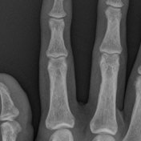

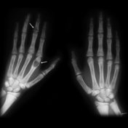
Radiographic Features
General: variable
Some changes resemble rickets
Generalized loss of bone density and thinning of bony cortices
Brown tumors, but these are less frequent.

Slide 21

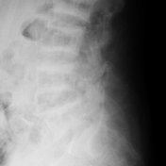
Osteosclerosis is typically evident in areas with a large proportion of cancellous bone such as the spine.
Osteosclerosis concentrated beneath the vertebral body endplates gives rise to the "rugger jersey" appearance

Slide 22
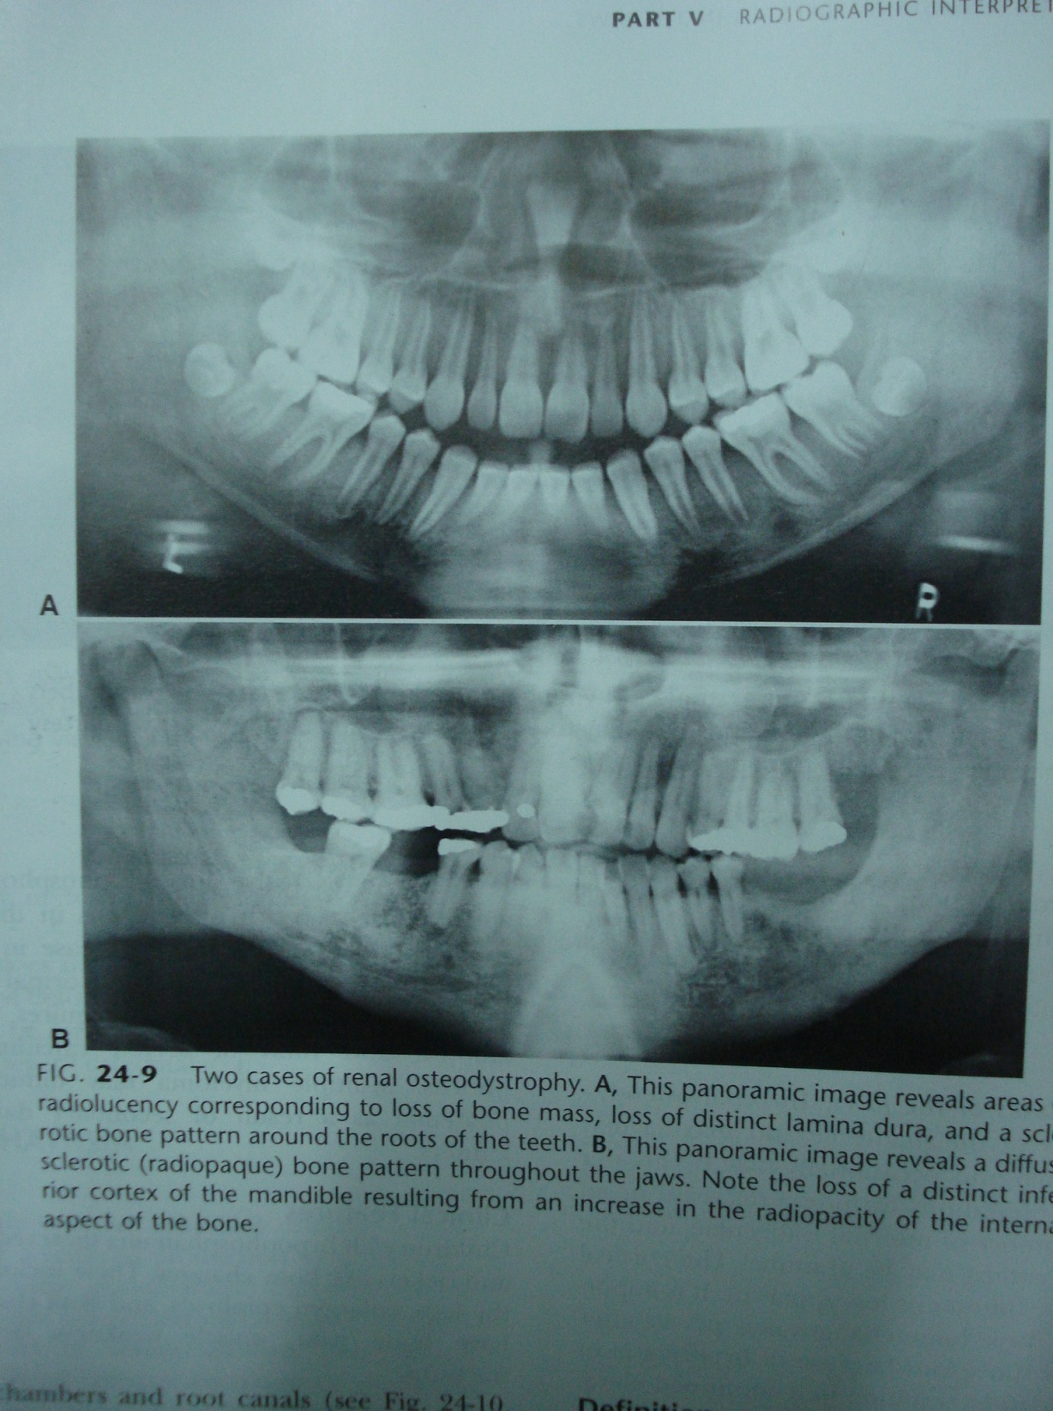
The jaws
Density of the mandible and maxilla may be less than normal
Decrease or an increase in the number of internal trabeculae, and the trabecular bone pattern may be granular.
Cortical boundaries may be thinner or less apparent.

Slide 23
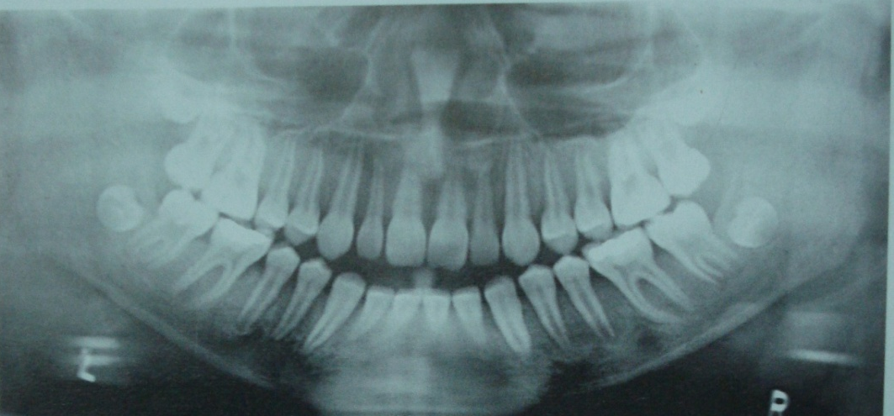
Teeth.
Hypoplasia and hypocalcification of the teeth
Loss of radiographic evidence of enamel - rarely.
The lamina dura may be absent or left apparent in instances of bone sclerosis .

Slide 24
Laboratories:
Elevated urea
Elevated phosphate
Elevated alkaline phosphatase
Elevated PTH
Decreased Calcium

Slide 25
TREATMENT :
Dietary phosphorus restriction- to 800-1000 mg daily when the serum phosphorus level is > 5.5 mg/dl (1.78 mmol/L )
Phosphate binders: to limit the absorption of dietary phosphorus
Vitamin D 1,00,000-2,00,000 I.U./ day

Slide 26
Conclusion
FOLs form a diverse wide spectrum of lesions, which are still evolving; in their classications.
Dentist usually come across intra-oral lesions at various stages and many of them can be managed easily by routine surgical modalities.
Certain lesions show aggressive nature and involve mid-face and sino-nasal areas. Such cases will need a multi-disciplinary approach for optimal treatment out-comes.

Slide 27
Refrences
RAVIKIRAN ONGOLE , PRAVEEN R.N. TEXTBOOK OF ORAL MEDICINE,ORAL DIAGNOSIS AND ORAL RADIOLOGY;3rd EDITION 2021
ORAL RADIOLOGY, STUART C. WHITE AND MICHAEL J. PHAROAH .PRINCIPLES & INTERPRETATION, 8TH EDITION 2018
FRENY R. KARJODKAR. ESSENTIALS OF ORAL & MAXILLOFACIAL RADIOLOGY 2ND EDITION 2019

Slide 28
Probable Questions
Describe Fibro-osseous lesions of the jaws.Discuss the clinical & Radiographic features of Fibrous Dysplasia
Radiographic features of Periapical Cemental Dysplasia
Clinical & Radiographic features of Pagets disease
Cherubisum
Renal Osteodystrophy

Slide 29
Thank you

